Slide 1
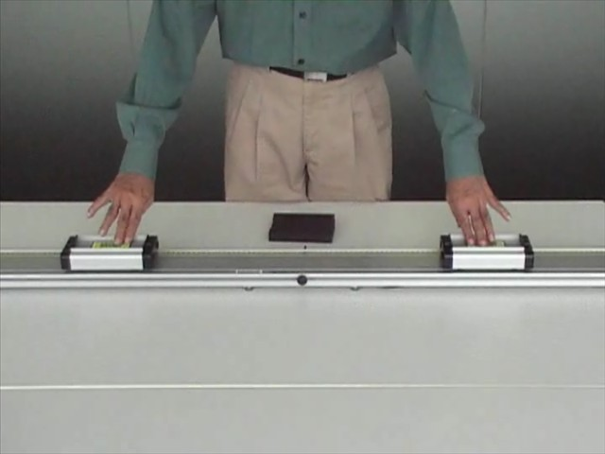
Watch this video…

Slide 2
Your challenge for the day!
For each of the scenarios shown in the video:
Examine the movement of the carriages before and after the collision.
Examine the factors affecting the outcome of the collisions.
Hence, predict the outcome of other collision scenarios.

